Slide 1
FIRE DETECTION WITH COMPUTER VISION
BITI3533 ARTIFICIAL INTELLIGENCE PROJECT MANAGEMENT
Group H Members:
Kaw Ji Zian(B032010029)
Md Fawzul Kabir Badhan(B031910459)
Yusuf Athallah Adriyansyah(B032010458)
Github Link: https://github.com/BadhanCS/Project
Lecuturer Name
PROF. TS. DR. BURHANUDDIN MOHD. ABOOBAIDER

Slide 2
DEFINING THE PROJECT
This project provides a computer vision-based fire detection and hazardous fire recognition technique by processing the video data generated by the ordinary camera. The suggested technique uses fire color and fluctuation characteristics to detect it.
Initially, the algorithm locates the regions of the video where there is motion from these regions, fire-colored pixels are collected and then wavelet transformation is used to ensure that the moving object is fire. Experimental findings show that the proposed technique is effective in detecting and classifying fire as hazardous or controlled.
BITI3533 - AIPM

Slide 3
Fire Detection using Computer Vision
Objectives
To detect fire by using the computer vision technology that will alert people by early detection of fire.
To protect human lives, material assets and the environment from the dangers and the effect of fire.
To detect fire with a different approach rather than using an existing system.
BITI3533 - AIPM

Slide 4
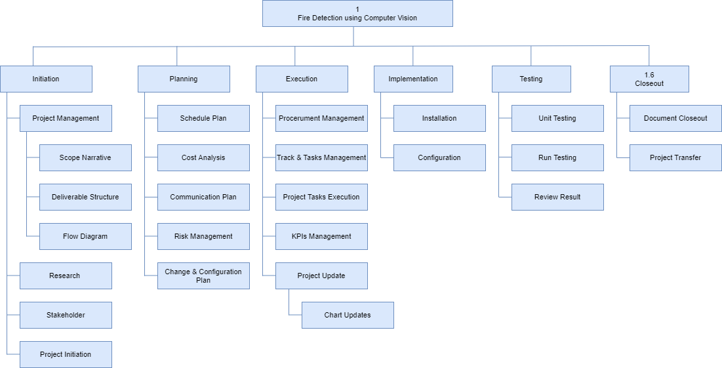
PLANNING THE PROJECT
Work Breakdown Structure
BITI3533 - AIPM

Slide 5
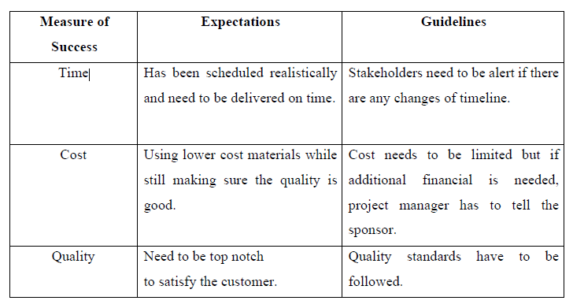
PLANNING THE PROJECT
Risk Identification Chart
BITI3533 - AIPM

Slide 6
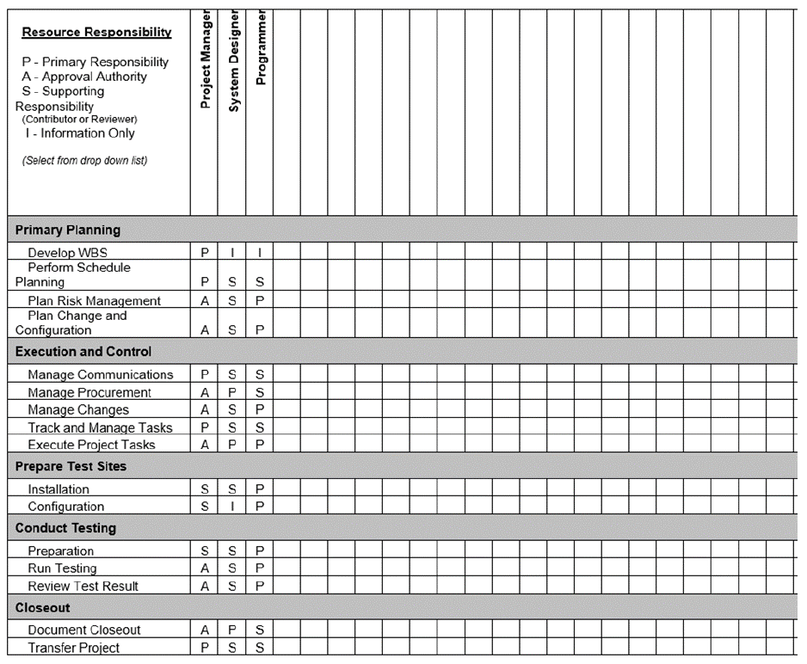
Responsibility Assignment Matrices (RAM)
BITI3533 - AIPM

Slide 7
PLANNING THE PROJECT
Project Manager - Kaw Ji Zian
A project manager is someone who has the overall responsibility for initiating, planning, designing, carrying out, monitoring, controlling, and successfully closing a project.
The project manager will organise the project calendar for the stakeholders, make sure that each step is carried out, conduct budget planning and process control, and troubleshoot any issues that arise. The project manager needs to possess more general managerial abilities as well as the capacity to ask widespread questions, recognise unintentional assumptions, and settle conflicts.
BITI3533 - AIPM

Slide 8
PLANNING THE PROJECT
System Designer - Md Fawzul Kabir Badhan
The system designer's job is to create a detailed blueprint and instructions that the programmers can follow. The specification of specifications that the system or business analyst has developed is the primary input document used by the system designer.
To guarantee that the system is thoroughly tested, the system designer must also create test schedules and collaborate with a group of users and system testers.
BITI3533 - AIPM

Slide 9
PLANNING THE PROJECT
Programmer - Yusuf Athallah Adriyansyah
A coevolutionary neural network has been used to construct an algorithm and a system, and the duty of the programmer is to define, develop, instal, and test a software framework that uses it. The software can be updated and maintained to make sure that security flaws are fixed and that it works with new databases once the final development environment has been given to the programmer.
On a computer or smartphone, programmers will create features that let users carry out basic operations, while other programmers will create the underpinning systems that manage networks.
BITI3533 - AIPM

Slide 10
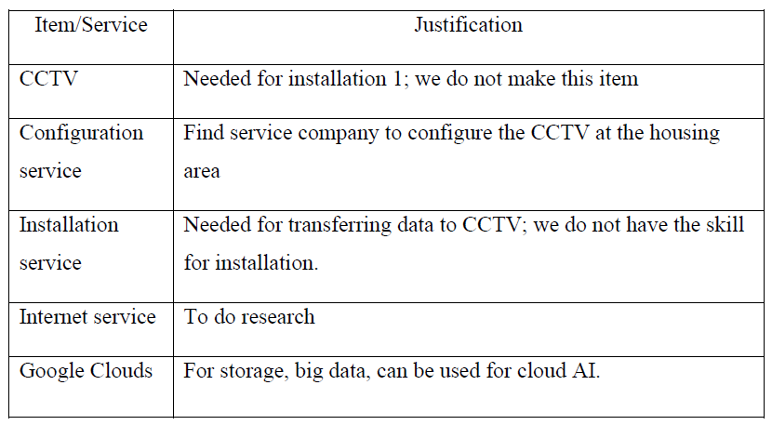
Project Planning Summary
Modules and Components
BITI3533 - AIPM

Slide 11
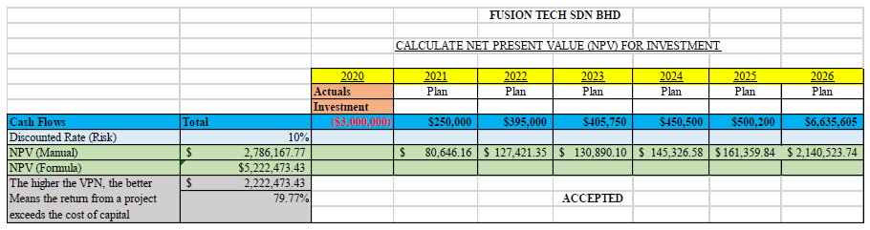
Project Planning Summary
Budget
BITI3533 - AIPM

Slide 12
IMPLEMENTING THE PROJECT PLAN
Deliverables
Successfully detecting the Fired-Colored Pixels.
Fire detection algorithm.
Final report of the system.
BITI3533 - AIPM

Slide 13
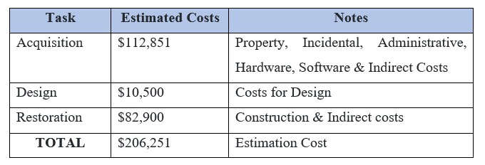
TASK AND ESTIMATED COST
BITI3533 - AIPM

Slide 14
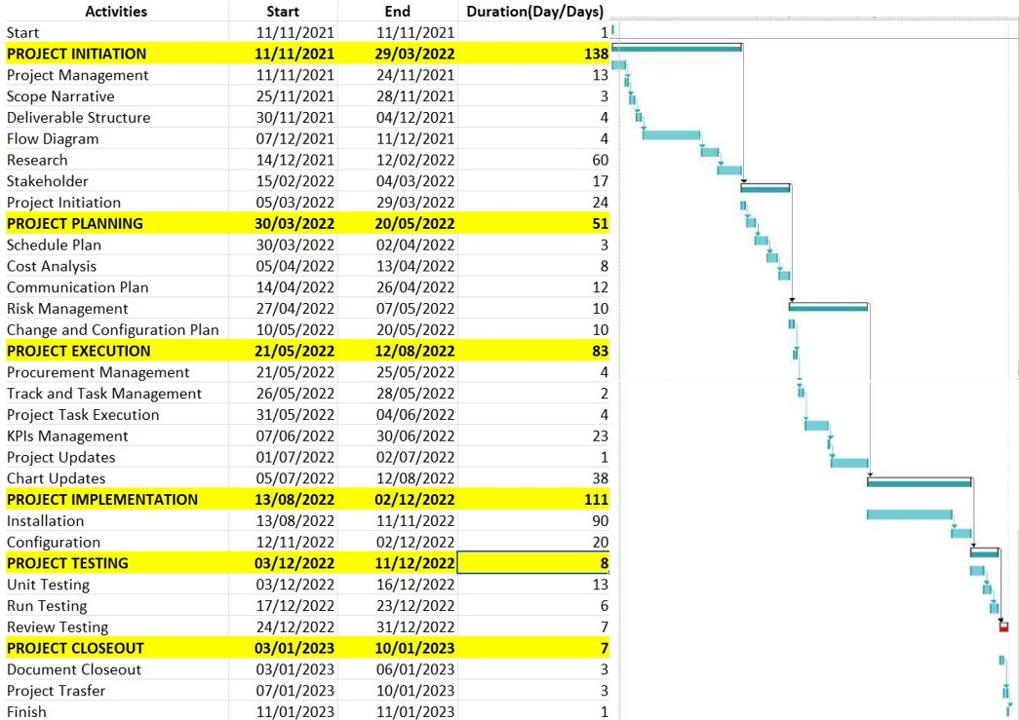
MILESTONE CHART
BITI3533 - AIPM

Slide 15
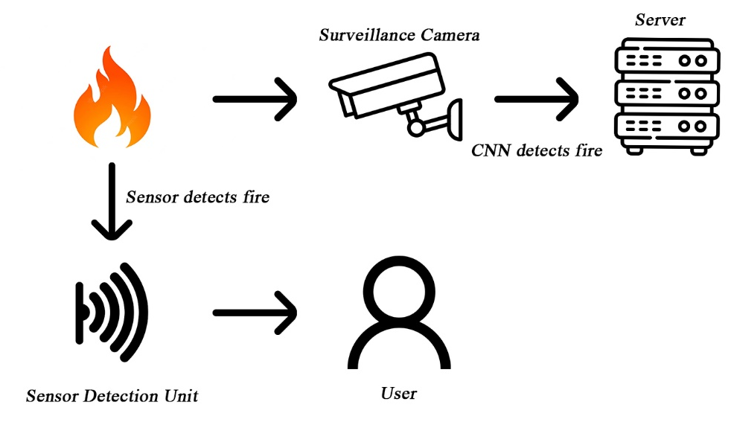
EXECUTING THE PROJECT
Project Design
BITI3533 - AIPM

Slide 16
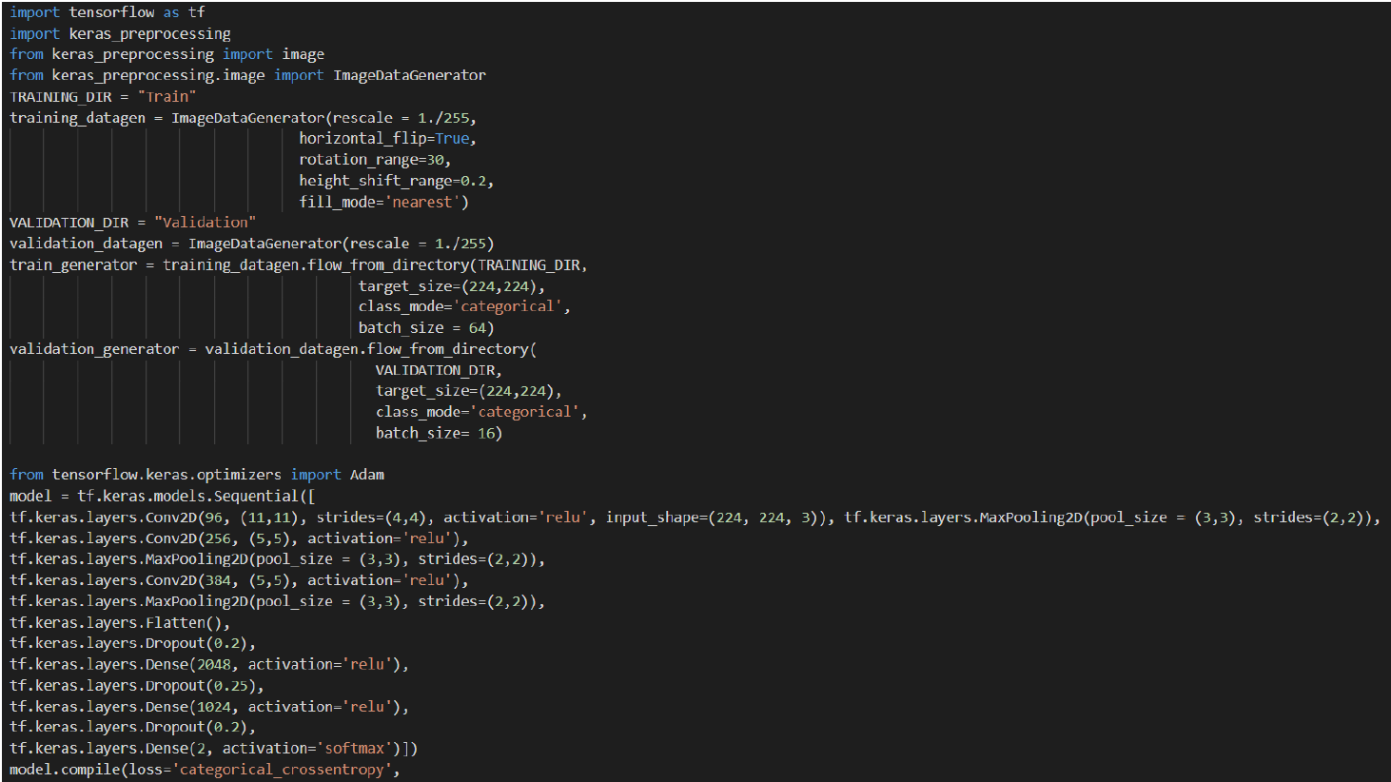
EXECUTING THE PROJECT
Coding (Customized CNN Architecture)
BITI3533 - AIPM

Slide 17
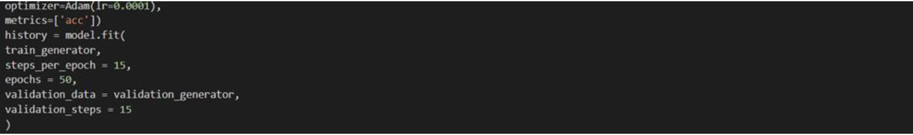
EXECUTING THE PROJECT
Coding (Customized CNN Architecture)
BITI3533 - AIPM

Slide 18
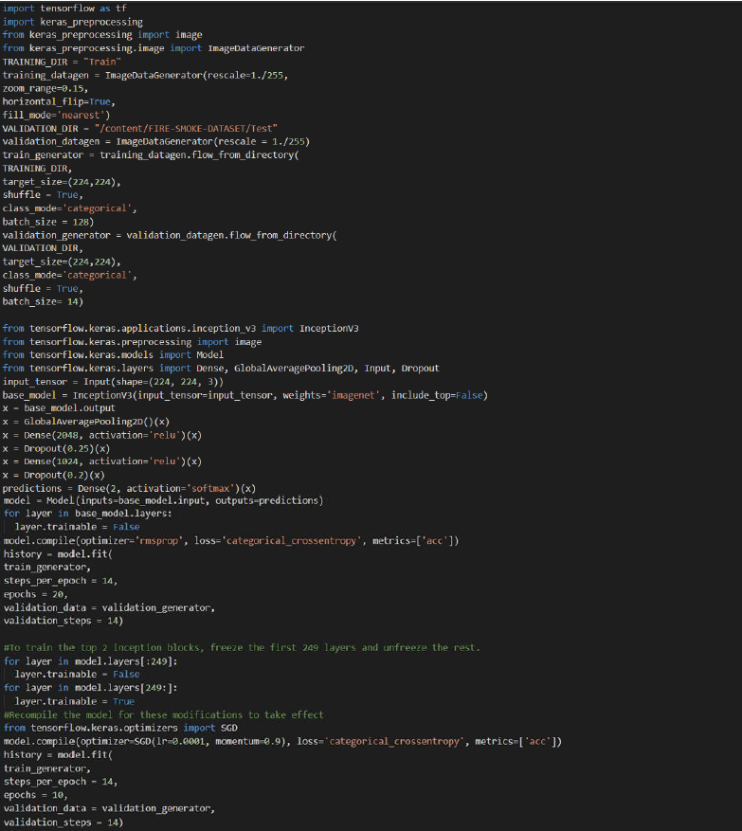
EXECUTING THE PROJECT
Coding (Inception V3 Model)
BITI3533 - AIPM

Slide 19
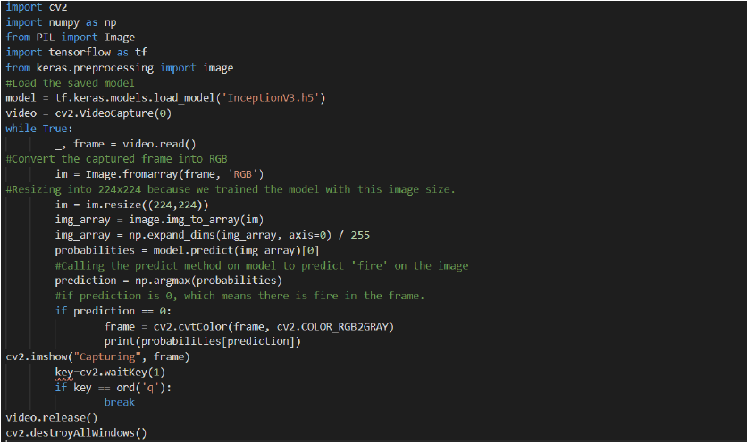
EXECUTING THE PROJECT
Coding (Real Time Testing)
BITI3533 - AIPM

Slide 20
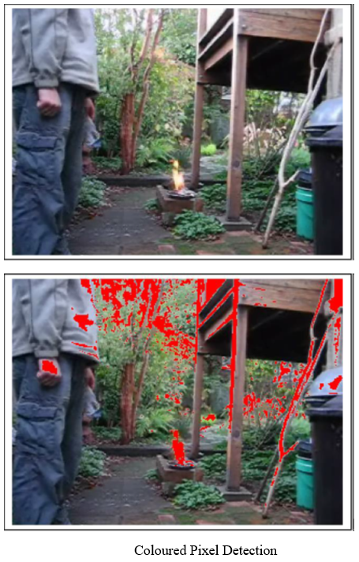
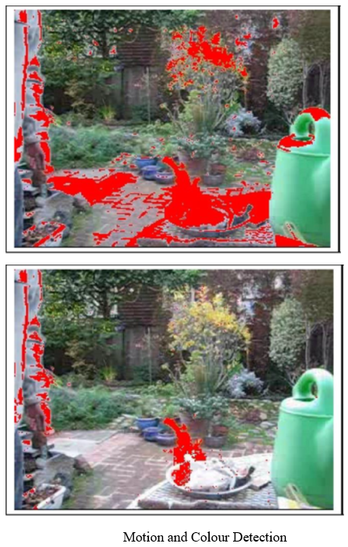
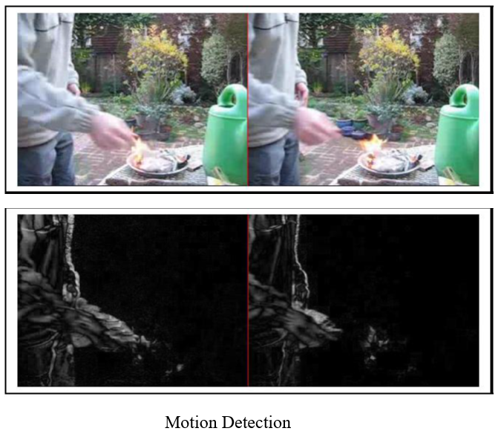
EXECUTING THE PROJECT
Output
BITI3533 - AIPM

Slide 21
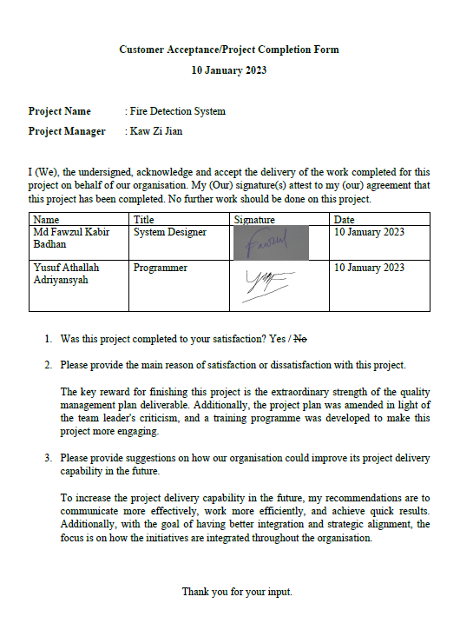
COMPLETING THE PROJECT
Acceptance/Project Completion Form
BITI3533 - AIPM

Slide 22
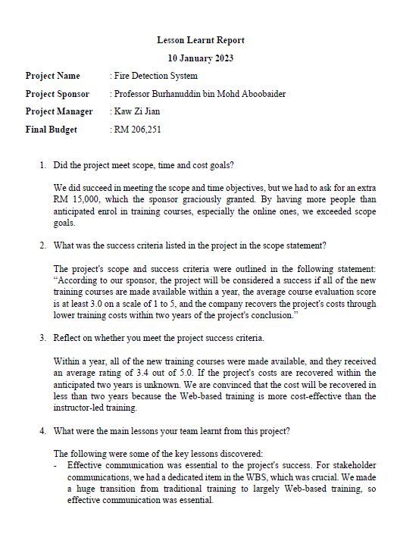
Lesson Learned

Slide 23


